Slide 1
Security in Cloud Computing

Slide 2
Cloud Computing Security
Cloud computing security is the set of control-based technologies and policies designed to adhere to regulatory compliance rules and protect information, data applications and infrastructure associated with cloud computing use.
Cloud computing security processes should address the security controls the cloud provider will incorporate to maintain the customer's data security, privacy and compliance with necessary regulations.

Slide 3
Cloud Security Challenges
Can you trust your data to your service provider?
With the cloud model, you lose control over physical security. In a public cloud, you are sharing computing resources with other companies.
Exposing your data in an environment shared with other companies could give the government “reasonable cause” to seize your assets because another company has violated the law. Simply because you share the environment in the cloud, may put your data at risk of seizure.

Slide 4
Cloud Security Challenges
If information is encrypted while passing through the cloud, who controls the encryption/decryption keys? Is it the customer or the cloud vendor?

Slide 5
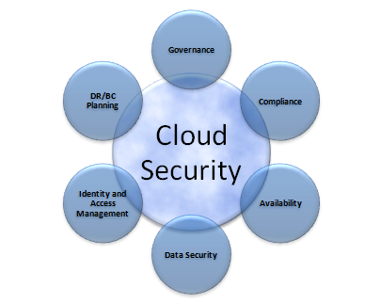
Cloud Security Challenges

Slide 6
Data Control Security
When the cloud provider goes down
This scenario has a number of variants: bankruptcy, deciding to take the business in another direction, or a widespread and extended outage. Whatever is going on, you risk losing access to your production systems due to the actions of another company. You also risk that the organization controlling your data might not protect it in accordance with the service levels to which they may have been previously committed.
When a subpoena compels your cloud provider to turn over your data
If the subpoena is directed at you, obviously you have to turn over the data to the courts, regardless of what precautions you take, but these legal requirements apply whether your data is in the cloud or on your own internal IT infrastructure. What we’re dealing with here is a subpoena aimed at your cloud provider that results from court action that has nothing to do with you.
To get at the data, the court will have to come to you and subpoena you. As a result, you will end up with the same level of control you have in your private data center.
Notes:
Subpoena:-a writ ordering a person to attend a court.

Slide 7
Data Control Security
When your cloud provider fails to adequately protect their network
When you select a cloud provider, you absolutely must understand how they treat physical, network, and host security. Though it may sound counterintuitive, the most secure cloud provider is one in which you never know where the physical server behind your virtual instance is running. Chances are that if you cannot figure it out, a determined hacker who is specifically targeting your organization is going to have a much harder time breaching the physical environment in which your data is hosted.
Nothing guarantees that your cloud provider will, in fact, live up to the standards and processes they profess to support.

Slide 8
Software as a service security
The technology analyst and consulting firm Gartner lists seven security issues which one should discuss with a cloud-computing vendor:
Privileged user access —inquire about who has specialized access to data, and about the hiring and management of such administrators.
Regulatory compliance—make sure that the vendor is willing to undergo external audits and/or security certifications.

Slide 9
Software as a service security
Data location—does the provider allow for any control over the location of data?
Data segregation —make sure that encryption is available at all stages, and that these encryption schemes were designed and tested by experienced professionals.

Slide 10
Software as a service security
Recovery —Find out what will happen to data in the case of a disaster. Do they offer complete restoration? If so, how long would that take?
Investigative support —Does the vendor have the ability to investigate any inappropriate or illegal activity?
Long-term viability —What will happen to data if the company goes out of business? How will data be returned, and in what format?

Slide 11
Risk Management
Effective risk management entails identification of technology assets; identification of data and its links to business processes, applications, and data stores; and assignment of ownership and custodial responsibilities.
To minimize risk in cloud
Develop a SaaS security strategy and build a SaaS Security reference architecture that reflects that strategy.
Balance risk and productivity.
Implement SaaS security controls.

Slide 12
Security Monitoring and Incident response
Security Monitoring
Supervises virtual and physical servers to continuously assess and measure data, application, or infrastructure behaviors for potential security threats.
Assures that the cloud infrastructure and platform function optimally while minimizing the risk of costly data breaches.

Slide 13
How Security Monitoring Works
Cloud monitoring can be done in the cloud platform itself, on premises using an enterprise’s existing security management tools, or via a third party service provider.
Some of the key capabilities of cloud security monitoring software include:
Scalability
Tools must be able to monitor large volumes of data across many distributed locations
Visibility
The more visibility into application, user, and file behavior that a cloud monitoring solution provides, the better it can identify potential attacks or compromises
Timeliness
The best cloud security monitoring solutions will provide constant monitoring, ensuring that new or modified files are scanned in real time

Slide 14
How Security Monitoring Works contd…
Integration
Monitoring tools must integrate with a wide range of cloud storage providers to ensure full monitoring of an organization’s cloud usage
Auditing and Reporting
Cloud monitoring software should provide auditing and reporting capabilities to manage compliance requirements for cloud security

Slide 15
Incident Response
Incident response is a term used to describe the process by which an organization handles a data breach or cyberattack, including the way the organization attempts to manage the consequences of the attack or breach (the “incident”). Ultimately, the goal is to effectively manage the incident so that the damage is limited and both recovery time and costs, as well as collateral damage such as brand reputation, are kept at a minimum.
Incident Response (IR) is one of the cornerstones of information security management: even the most diligent planning, implementation, and execution of preventive security controls cannot completely eliminate the possibility of an attack on the Confidentiality, Integrity, or Availability of information assets.

Slide 16
Steps for incident response
Preparation - The most important phase of incident response is preparing for an inevitable security breach. Preparation helps organizations determine how well their CIRT(computer incident response team) will be able to respond to an incident and should involve policy, response plan/strategy, communication, documentation, determining the CIRT members, access control, tools, and training.
Identification - Identification is the process through which incidents are detected, ideally promptly to enable rapid response and therefore reduce costs and damages. For this step of effective incident response, IT staff gathers events from log files, monitoring tools, error messages, intrusion detection systems, and firewalls to detect and determine incidents and their scope.
Containment - Once an incident is detected or identified, containing it is a top priority. The main purpose of containment is to contain the damage and prevent further damage from occurring (as noted in step number two, the earlier incidents are detected, the sooner they can be contained to minimize damage). It’s important to note that all of SANS(SysAdmin, Audit, Network, and Security.)’ recommended steps within the containment phase should be taken, especially to “prevent the destruction of any evidence that may be needed later for prosecution.” These steps include short-term containment, system back-up, and long-term containment.
Notes:
SANS:

Slide 17
Steps for incident response
Eradication - Eradication is the phase of effective incident response that entails removing the threat and restoring affected systems to their previous state, ideally while minimizing data loss. Ensuring that the proper steps have been taken to this point, including measures that not only remove the malicious content but also ensure that the affected systems are completely clean, are the main actions associated with eradication.
Recovery - Testing, monitoring, and validating systems while putting them back into production in order to verify that they are not re-infected or compromised are the main tasks associated with this step of incident response. This phase also includes decision making in terms of the time and date to restore operations, testing and verifying the compromised systems, monitoring for abnormal behaviors, and using tools for testing, monitoring, and validating system behavior.
Lessons Learned - Lessons learned is a critical phase of incident response because it helps to educate and improve future incident response efforts. This is the step that gives organizations the opportunity to update their incident response plans with information that may have been missed during the incident, plus complete documentation to provide information for future incidents. Lessons learned reports give a clear review of the entire incident and may be used during recap meetings, training materials for new CIRT members, or as benchmarks for comparison.

Slide 18
Security Architecture Design
A security architecture framework should be established with consideration of processes (enterprise authentication and authorization, access control, confidentiality, integrity, nonrepudiation, security management, etc.), operational procedures, technology specifications, people and organizational management, and security program compliance and reporting.
Technology and design methods should be included, as well as the security processes necessary to provide the following services across all technology layers:
1. Authentication
2. Authorization
3. Availability
4. Confidentiality
5. Integrity
6. Accountability
7. Privacy

Slide 19
Security Architecture Design
The creation of a secure architecture provides the engineers, data center operations personnel, and network operations personnel a common blueprint to design, build, and test the security of the applications and systems. Design reviews of new changes can be better assessed against this architecture to assure that they conform to the principles described in the architecture, allowing for more consistent and effective design reviews.

Slide 20
SaaS Security Architecture Goals
Protection of information. It deals with prevention and detection of unauthorized actions and ensuring confidentiality, integrity of data.
Robust tenant data isolation
Flexible RBAC(Role-based access control – Prevent unauthorized action
Proven Data Security
Prevention of Web related top threats as per OWASP( Open Web Application Security Project )
Strong Security Audit Logs

Slide 21
Vulnerability Assessment
Vulnerability assessment classifies network assets to more efficiently prioritize vulnerability-mitigation programs, such as patching and system upgrading.
It measures the effectiveness of risk mitigation by setting goals of reduced vulnerability exposure and faster mitigation.
Vulnerability management should be integrated with discovery, patch management, and upgrade management processes to close vulnerabilities before they can be exploited.

Slide 22
Vulnerability Assessment
Vulnerability assessment is not Penetration Testing i.e. it does not simulate the external or internal cyber attacks that aims to breach the information security of the organization
A vulnerability assessment attempts to
identify the exposed vulnerabilities of a specific host,
or possibly an entire network

Slide 23
Data Privacy and Security
What is Data Privacy?
To preserve and protect any personal information, collected by any organization, from being accessed by a third party.
Determine what data within a system can be shared with others and which should be restricted.
What is Data Security?
Data Security refers to protecting data from unauthorized access and data corruption throughout its lifecycle.
Data security refers to data encryption, tokenization and key management practices that protect data across all applications and platforms.

Slide 24
Disaster Recovery
Disaster Recovery deals with catastrophic failures that are extremely unlikely to occur during the lifetime of a system.
Although each single disaster is unexpected over the lifetime of a system, the possibility of some disaster occurring over time is reasonably nonzero.

Slide 25
Disaster Recovery Plan
Disaster Recovery plan involves two key metrices:
Recovery Point Objective (RPO)
The recovery point objective identifies how much data you are willing to lose in the event of a disaster. This value is typically specified in a number of hours or days of data. For example, if you determine that it is OK to lose 24 hours of data, you must make sure that the backups you’ll use for your disaster recovery plan are never more than 24 hours old.
Recovery Time Objective (RTO)
The recovery time objective identifies how much downtime is acceptable in the event of a disaster. If your RTO is 24 hours, you are saying that up to 24 hours may elapse between the point when your system first goes offline and the point at which you are fully operational again.

Slide 26
Disaster Recovery Plan
Everyone would love a disaster recovery scenario in which no downtime and no loss of data occur, no matter what the disaster. The nature of a disaster, however, generally requires you to accept some level of loss; anything else will come with a significant price tag.
the cost of surviving with zero downtime and zero data loss could have been having multiple data centres in different geographic locations that were constantly synchronized.
Accomplishing that level of redundancy is expensive. It would also come with a nontrivial performance penalty.
Determining an appropriate RPO and RTO is ultimately a financial calculation: at what point does the cost of data loss and downtime exceed the cost of a backup strategy that will prevent that level of data loss and downtime?

Slide 27
Disaster Recovery Plan
The easiest place to start is your RPO.
Your RPO is typically governed by the way in which you save and back up data:
• Weekly off-site backups will survive the loss of your data centre with a week of data loss. Daily off-site backups are even better.
• Daily on-site backups will survive the loss of your production environment with a day of data loss plus replicating transactions during the recovery period after the loss of the system. Hourly on-site backups are even better.
• A NAS/SAN will survive the loss of any individual server, except for instances of data corruption with no data loss.
• A clustered database will survive the loss of any individual data storage device or database node with no data loss.
• A clustered database across multiple data centres will survive the loss of any individual data center with no data loss.

Slide 28
Disasters in the Cloud
Assuming unlimited budget and capabilities, three key things in disaster recovery planning to be focused:
1. Backups and data retention
2. Geographic redundancy
3. Organizational redundancy
Fortunately, the structure of the Amazon cloud makes it very easy to take care of the first and second items. In addition, cloud computing in general makes the third item much easier.

Slide 29
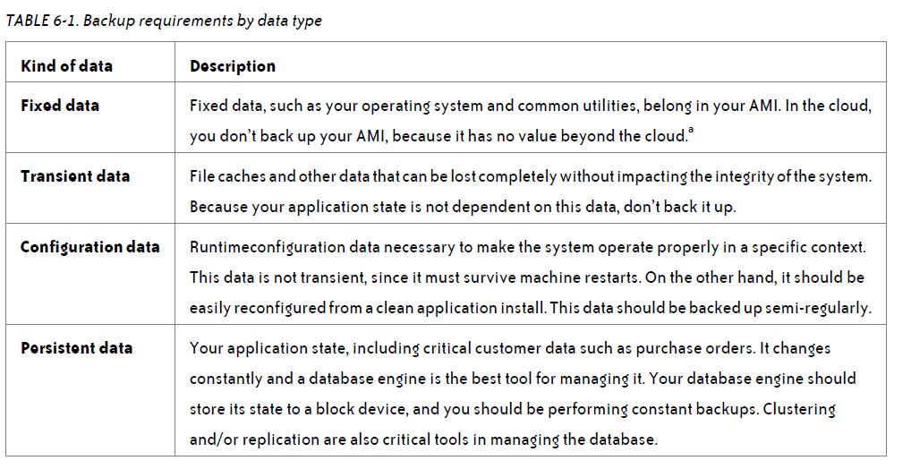
Backup management

Slide 30
Configuration data backup strategy
Create regular—at a minimum, daily—snapshots of your configuration data.
Create semi-regular—at least less than your RPO—filesystem archives in the form of ZIP or TAR files and move those archives into Amazon S3.
On a semi-regular basis—again, at least less than your RPO—copy your filesystem archives out of the Amazon cloud into another cloud or physical hosting facility.

Slide 31
Persistent data backup strategy (aka database backups)
• Set up a master with its data files stored on a block storage device.
• Set up a replication slave, storing its data files on a block storage device.
• Take regular snapshots of the master block storage device based on my RPO.
• Create regular database dumps of the slave database and store them in S3.
• Copy the database dumps on a semi-regular basis from S3 to a location outside the Amazon cloud.

Slide 32
taking snapshots or creating database dumps for some database engines is actually very tricky in a runtime environment,
You need to freeze the database only for an instant to create your snapshot. The process follows these steps:
1. Lock the database.
2. Sync the filesystem (this procedure is filesystem-dependent).
3. Take a snapshot.
4. Unlock the database.

Slide 33
Geographic Redundancy
If you can develop geographical redundancy, you can survive just about any physical disaster that might happen. With a physical infrastructure, geographical redundancy is expensive.
In the cloud, however, it is relatively cheap.
No need to have your application running actively in all locations, but you need the ability to bring your application up from the redundant location in a state that meets your Recovery Point Objective within a timeframe that meets your Recovery Time Objective.
Amazon provides built-in geographic redundancy in the form of regions and availability zones.

Slide 34
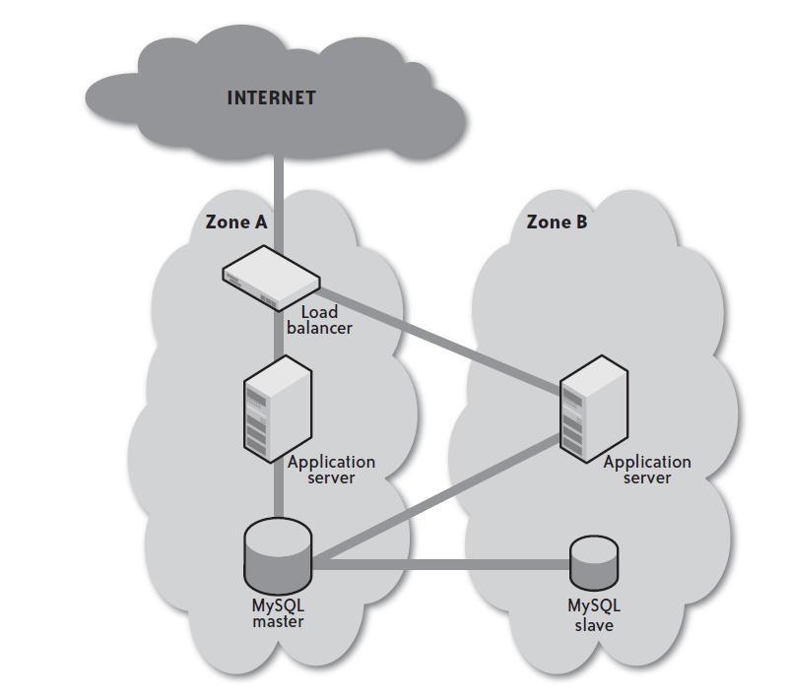
Geographic Redundancy

Slide 35
Organizational Redundancy
Physical disasters are a relatively rare thing, but companies go out of business everywhere every day—even big companies like Amazon and Rackspace. Even if a company goes into bankruptcy restructuring, there’s no telling what will happen to the hardware assets that run their cloud infrastructure. Your disaster recovery plan should therefore have contingencies that assume your cloud provider simply disappears from the face of the earth.
the best approach to organizational redundancy is to identify another cloud provider and establish a backup environment with that provider in the event your first provider fails.

Slide 36
Disaster Management
To complete the disaster recovery scenario, you need to recognize when a disaster has happened and have the tools and processes in place to execute your recovery plan.
Monitoring
Monitoring your cloud infrastructure is extremely important. You cannot replace a failing server or execute your disaster recovery plan if you don’t know that there has been a failure.
Monitoring must be independent of your clouds.
you should be checking capacity issues such as disk usage, RAM, and CPU.
you will need to monitor for failure at three levels:
• Through the provisioning API (for Amazon, the EC2 web services API)
• Through your own instance state monitoring tools
• Through your application health monitoring tools

Slide 37
Disaster Management
Load Balancer Recovery
One of the reasons companies pay absurd amounts of money for physical load balancers is to greatly reduce the likelihood of load balancer failure.
With cloud vendors such as GoGrid—and in the future, Amazon—you can realize the benefits of hardware load balancers withoutincurring the costs.
Recovering a load balancer in the cloud, however, is lightning fast. As a result, the downside of a failure in your cloud-based load balancer is minor.

Slide 38
Disaster Management
Application Server Recovery
If you are operating multiple application servers in multiple availability zones, your system as a whole will survive the failure of any one instance—or even an entire availability zone. You will still need to recover that server so that future failures don’t affect your infrastructure.
The recovery of a failed application server is only slightly more complex than the recovery of a failed load balancer. Like the failed load balancer, you start up a new instance from the application server machine image. You then pass it configuration information, including where the database is.

Slide 39
Disaster Management
Database Recovery
Database recovery is the hardest part of disaster recovery in the cloud. Your disaster recovery algorithm has to identify where an uncorrupted copy of the database exists. This process may involve promoting slaves into masters, rearranging your backup management, and reconfiguring application servers.
The best solution is a clustered database that can survive the loss of an individual database server without the need to execute a complex recovery procedure.
The following process will typically cover all levels of database failure:
1. Launch a replacement instance in the old instance’s availability zone and mount its old volume.
2. If the launch fails but the volume is still running, snapshot the volume and launch a new instance in any zone, and then create a volume in that zone based on the snapshot.
3. If the volume from step 1 or the snapshot from step 2 are corrupt, you need to fall back to the replication slave and promote it to database master.
4. If the database slave is not running or is somehow corrupted, the next step is to launch a replacement volume from the most recent database snapshot.
5. If the snapshot is corrupt, go further back in time until you find a backup that is not corrupt.

Slide 40
Multi-tenancy Issues in the Cloud
Multi-tenancy security refers to data safety or privacy of tenants’ data in a multi-tenancy environment.
The biggest driving force of multi-tenancy hosting is efficiency and low maintenance cost.
Offering dozens or hundreds of tenants access to the same application or database other tenants are using raises the possibility of one of them using someone else’s data either by malice or accident.
This makes security a primary concern in multi-tenancy.
Notes:
Who are my neighbors? What is their objective? They present another facet of risk and trust requirements

Slide 41
Security. Putting your data into someone else’s hands and running your software using someone else’s CPU is a great risk and requires a tremendous amount of trust. Some of the well-known cloud security issues are data loss, hacks, and some others. The multi-tenancy model introduced new security challenges and vulnerabilities that require new techniques to deal with. The examples could be the following: one tenant gaining access to the neighbor’s data, data is accidentally returned to the wrong tenant, or one tenant negatively affecting another in terms of resource sharing. These vulnerabilities can be exploited for personal gain.
Performance. Because SaaS applications reside in different locations, the response time in accessing the may vary from time to time. While cloud infrastructure focuses on enhancing the overall system performance as a whole, it is impossible to predict the response time of a specific application, and in general SaaS applications run at slightly lower speeds than server applications.

Slide 42
Interoperability. Each cloud provider has its own way of how clients, applications and users interact with the cloud. This undermines the development of cloud ecosystems by forcing the clients to be locked in with a particular provider. This prohibits the users to choose from alternative vendors and providers in order to optimize the performance within their company/organization. Proprietary cloud APIs make it extremely difficult to integrate cloud services with an organization’s own existing system, such as an on-premises data center. The goal of interoperability is to create seamless fluid data across clouds and between cloud and local applications.

Slide 43
Virtual Machine Security
Virtual machines are the containers in which applications and guest operating systems run. By design, all VMware virtual machines are isolated from one another. This isolation enables multiple virtual machines to run securely while sharing hardware and ensures both their ability to access hardware and their uninterrupted performance.
Each virtual machine is isolated from other virtual machines running on the same hardware. Although virtual machines share physical resources such as CPU, memory, and I/O devices, a guest operating system on an individual virtual machine cannot detect any device other than the virtual devices made available to it.

Slide 44
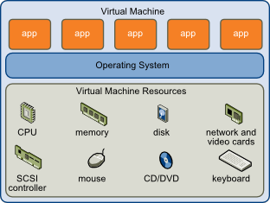

Slide 45
In the cloud environment, physical servers are consolidated to multiple virtual machine instances on virtualized servers. Not only can data center security teams replicate typical security controls for the data center at large to secure the virtual machines, they can also advise their customers on how to prepare these machines for migration to a cloud environment when appropriate.
Firewalls, intrusion detection and prevention, integrity monitoring, and log inspection can all be deployed as software on virtual machines to increase protection and maintain compliance integrity of servers and applications as virtual resources move from on-premises to public cloud environments.

Slide 46
Security Issues in Cloud Computing
Data Loss – Data Loss is one of the issues faced in Cloud Computing. This is also known as Data Leakage. As we know that our sensitive data is in the hands of Somebody else, and we don’t have full control over our database. So if the security of cloud service is to break by hackers then it may be possible that hackers will get access to our sensitive data or personal files.
Interference of Hackers and Insecure API’s – As we know if we are talking about the cloud and its services it means we are talking about the Internet. Also, we know that the easiest way to communicate with Cloud is using API. So it is important to protect the Interface’s and API’s which are used by an external user. But also in cloud computing, few services are available in the public domain. It is the vulnerable part of Cloud Computing because it may be possible that these services are accessed by some third parties. So it may be possible that with the help of these services hackers can easily hack or harm our data.

Slide 47
User Account Hijacking – Account Hijacking is the most serious security issue in Cloud Computing. If somehow the Account of User or an Organization is hijacked by Hacker. Then the hacker has full authority to perform Unauthorized Activities.
Changing Service Provider –Vendor lock In is also an important Security issue in Cloud Computing. Many organizations will face different problems while shifting from one vendor to another. For example, An Organization wants to shift from AWS Cloud to Google Cloud Services then they ace various problem’s like shifting of all data, also both cloud services have different techniques and functions, so they also face problems regarding that. Also, it may be possible that the charges of AWS are different from Google Cloud, etc.

Slide 48
Lack of Skill – While working, shifting o another service provider, need an extra feature, how to use a feature, etc. are the main problems caused in IT Company who doesn’t have skilled Employee. So it requires a skilled person to work with cloud Computing.
Denial of Service (DoS) attack – This type of attack occurs when the system receives too much traffic. Mostly DoS attacks occur in large organizations such as the banking sector, government sector, etc. When a DoS attack occurs data is lost. So in order to recover data, it requires a great amount of money as well as time to handle it.

